Slide 1
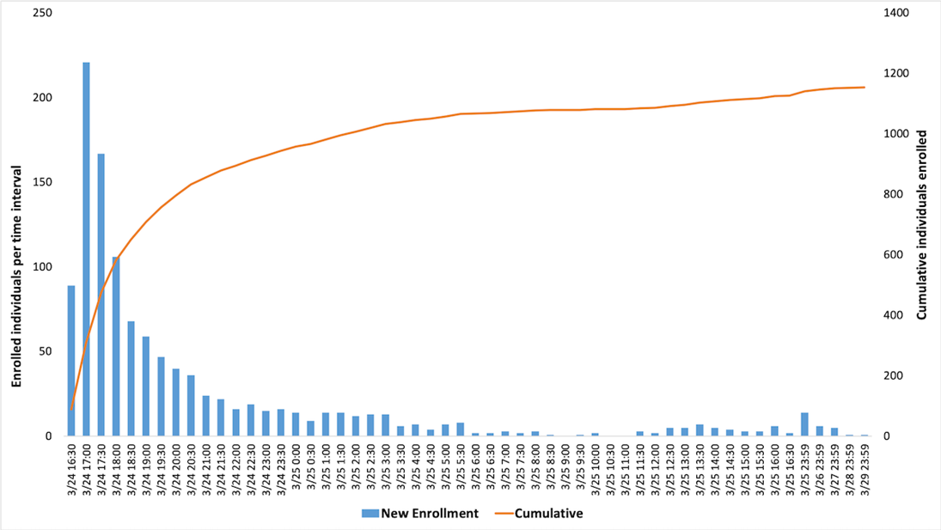
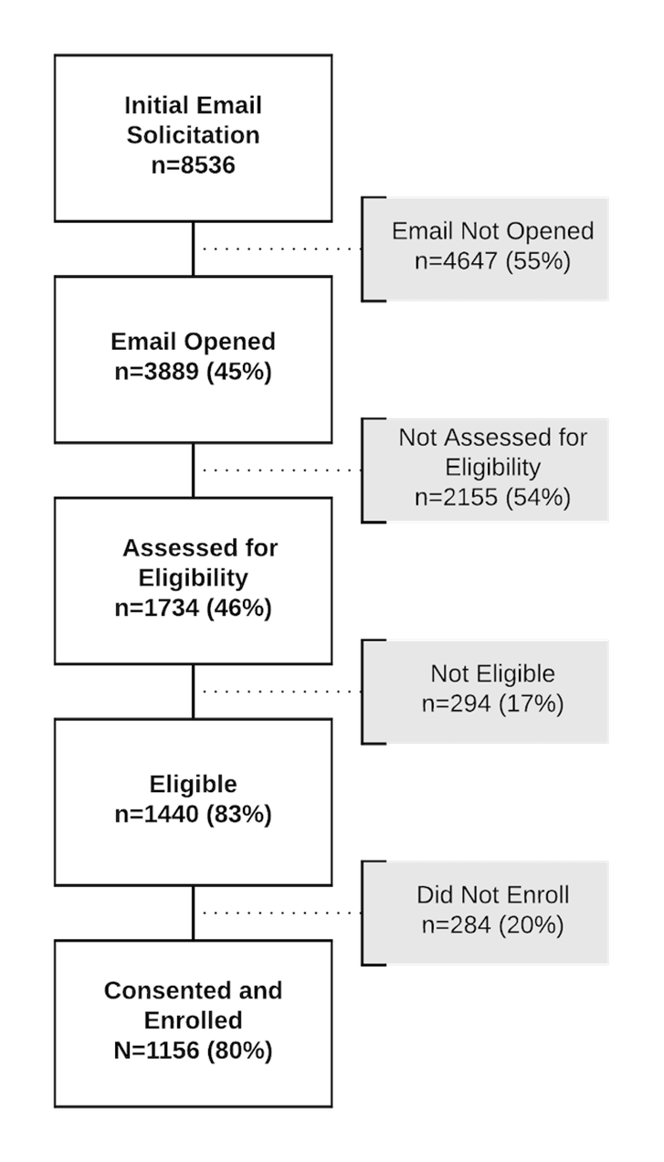
Bolstering Research Study Recruitment Speed And Retention Rate in a Nationwide Web-Based Sleep Study
Sean Deering,^{1,2} Jessie Juusola,³ Benjamin Bradshaw, ³ Luca Foschini,³ Adam Amdur,² Carl Stepnowsky, PhD^{1,4}
¹Health Services Research & Development Unit, VASDHS; ²American Sleep Apnea Association; ³Evidation Health, Inc; ⁴Dept. Of Medicine, UCSD
Introduction
Results
Discussion
Study Objectives
This study sought to take advantage of technological and methodological advancements in the field of Mobile Health (mHealth) research and apply them to a large-scale longitudinal study on sleep and activity.
Large-scale studies of sleep patterns, quality, and associated characteristics substantiated by objective data are lacking.
Utilizing a novel platform (Achievement Studies, Evidation Health, San Mateo, CA) we tried to gain further insights into the relationship between sleep and activity while simultaneously speeding up the recruitment process and maximizing participant engagement and data completeness.
Conclusions
Conducting online, community-based longitudinal studies that include objective sleep and activity data is an innovative approach to carrying out research.
Carrying out research using the Evidation Achievement platform allowed for extremely rapid recruitment of participants.
Overall study retention was very good, with 75% and 60% of users still actively participating at the 3-month and one 1-year time points, respectively.
Limitations
As is the case with all large community-based studies, data quality must be carefully examined. In addition, the representativeness of the sample to the overall population will need to be evaluated.
Methods
Figure 1. Participant Enrollment Rate. The histogram depicts participant enrollment by date/time bin. Blue bars represent the number of participants recruited at each date/time and the orange line shows cumulative enrollment. 394 participants were recruited in the first hour, and 1000 were recruited in the first 9 hours.
Participants
During a 5-day recruitment period, 1156 participants were enrolled. Participant retention was 75% at 3 months and 60% at one year.
40% of participants who were still participating at the 1 year time point completed 7/7 days of the Sleepiness Checker.
Study Measures
98% of enrolled participants completed baseline questionnaires.
91% of participants completed baseline Sleepiness Checker.
Mean days of sleepiness checker completed was 5.7 ± 1.7
(1-7). 51% of participants completing 7 consecutive days of the sleepiness checker.
Participant self-reported TST was 391.2 ± 108 minutes.
Wearable Data
85% of participants provided sleep-specific wearable data; 87% of participants provided activity-specific wearable data.
At baseline, wearable data indicated that participants slept an average of 302.8 ± 98.1 minutes per night (63-576)
Overview
A subset of Achievement community members with variability in bedtime were invited to the study by e-mail and assessed for eligibility.
Participants
Eligible participants went on to complete an electronic consent process and a series of baseline questionnaires. Participants could access the online study platform from any computer or web-enabled mobile device.
Study Measures
Questionnaires completed at baseline included About Me, My Family, Research Interest, Sleep Habits, Sleep Assessment, My Health (adapted from the SleepHealth Mobile App Study, American Sleep Apnea Association).
Questionnaires assessed participant background demographic information, family information, research interest, sleep and health-specific information.
Participants were prompted to complete a 7-day Sleepiness Checker activity (Karolinska Sleepiness Scale (KSS)) at baseline, 3 months, 6 months, 9 months and one year.
Participants were asked to connect a supported wearable device through the study dashboard. This allowed objective sleep and activity data to be collected by the research team over the course of the study.
Figure 2. Study Participant Flow. White Boxes show steps of enrollment process and number/percent of total valid N, gray boxes show number of N lost in between each step.
References
Åkerstedt T, and Gillberg, M, Subjective and objective sleepiness in the active individual,” International Journal of Neuroscience, 52(12).29-37.1990.
SleepHealth Mobile App Study. American Sleep Apnea Association. https://www.sleephealth.org/sleephealthapp.
Evidation Achievement Platform. Evidation Health. https://www.myachievement.com.
Notes:
1

